Slide 1
Neural Networks and Neuron
Jack Wu

Slide 2
Why Neural Networks?
Isn’t linear classifier good enough?

Slide 3
Review: Classifier
Input (x)
Classifier Model
Output / Prediction (y)

Slide 4
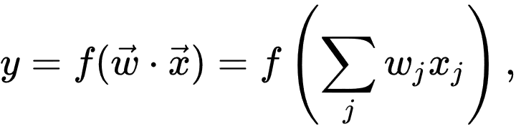
Linear Classifier A Linear Classifier makes a classification decision based on the value of a linear combination of the Features(ωj).
+
-
-
-
-
+
-
+
-
-
+
+
+
-
-
+
+
+
-
-
+
-
+
+
+
Score(x) > 0
Score(x) = 0
Score(x) < 0
In 2-D, the decision boundary is a line, in more dimensions, the decision boundary is a hyper-plane.

Slide 5
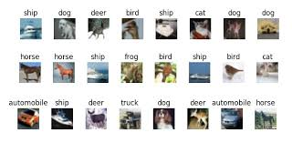
Image Classification
Input (x): Image
Classifier Model
Output (y): Predicted Object
And after all that learning and modeling, what are these?
Image from the CIFAR-10 dataset.

Slide 6
The goal for neural network is to build a MUCH more complex classifier.

Slide 7
Neuron
Just a bit biology to explain what neuron is…

Slide 8
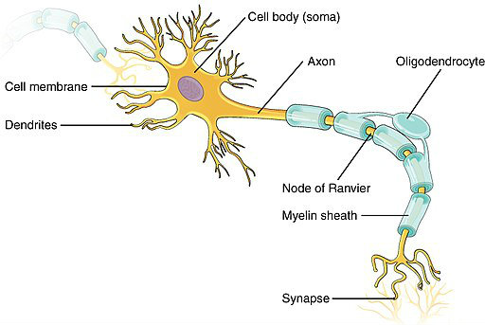
Neuron
Basically, the Axon sends out a signal (electric pulse), and the Dendrites receives the signal sent by another axon. The Synapse is what connects an input to another output.
The main idea is that one single neuron does nothing more but transfer an impulse to another nerve, and many nerves connect to each other to form a network (Our lovely brain).
Image Source: https://www.wholelifechallenge.com/how-to-mobilize-your-nerves-and-why-you-might-do-it/

Slide 9
END

Slide 10
UNUSED SLIDES

